Slide 1
EPFL Space Center eSpace
Space Propulsion ENG-510

Slide 2
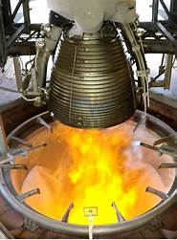
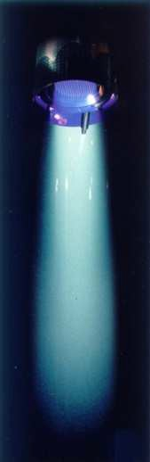
Lecture # 7 Electrical Propulsion Systems
Brief overview on all space propulsion systems

Slide 3
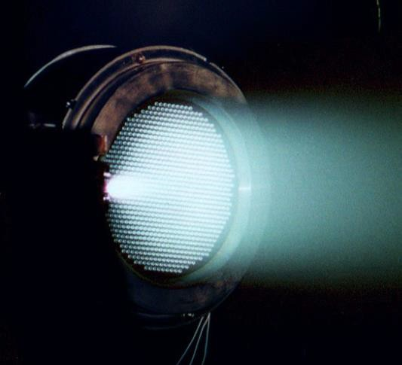
Which Electrical Propulsion Systems exist?
L7 – Propulsion Systems
Space Propulsion ENG-510

Slide 4
Which Electrical Propulsion Systems exist?
Electrical Propulsion Systems:
Thermal Propulsion Systems
Material Ejection
L7 – Propulsion Systems
Space Propulsion
Space Propulsion ENG-510
Chemical Propulsion Systems
Non-Material Ejection
Electrical Propulsion Systems

Slide 5
Thermal Propulsion Systems
ResistojetThruster
Electrothermal
Arcjet Thruster
Electrostatic
L7 – Propulsion Systems
Electrical Propulsion Systems
MPD Thruster
Space Propulsion ENG-510
Pulsed Plasma Thruster
Helicon Thruster
Electromagnetic
Magnetic Nozzle

Slide 6
Which Electrical Propulsion Systems exist?
Electrical Propulsion Systems:
Basics
Electrothermal (or part of Thermal Propulsion Systems…)
Power heats propellant
Expansion through a nozzle (same as for a chemical thruster)
Electrostatic
Propellant is ionized
Accelerated using electrostatic fields
Electromagnetic
Propellant is ionized
Accelerated by interaction of discharge current with magnetic field (JxB Lorentz force)
L7 – Propulsion Systems
Space Propulsion ENG-510

Slide 7
Which Electrical Propulsion Systems exist?
Electric Propulsion Systems:
B
C
D
L7 – Propulsion Systems
Space Propulsion ENG-510

Slide 8
Thermal Propulsion Systems
ResistojetThruster
Electrothermal
Arcjet Thruster
Electrostatic
L7 – Propulsion Systems
Electrical Propulsion Systems
MPD Thruster
Space Propulsion ENG-510
Pulsed Plasma Thruster
Helicon Thruster
Electromagnetic
Magnetic Nozzle

Slide 9
Which Electrical Propulsion Systems exist?
Electromagnetic Propulsion Systems:
Magnetoplasmadynamic Thruster
MPD thrusters are electromagnetic devices that use a very high current arc to ionize a significant fraction of the propellant and then electromagnetic forces (Lorentz J x B forces) in the plasma discharge to accelerate the charged propellant
Since both the current and the magnetic field are usually generated by the plasma discharge, MPD thrusters tend to operate at very high powers in order to generate sufficient force for high specific impulse operation and thereby also generate high thrust compared to the other EP systems
L7 – Propulsion Systems
Space Propulsion ENG-510

Slide 10
Which Electrical Propulsion Systems exist?
Electromagnetic Propulsion Systems:
Magnetoplasmadynamic Thruster
There are two main types of MPD thrusters, applied-field and self-field
Applied-field thrusters have magnetic rings surrounding the exhaust chamber to produce the magnetic field, while self-field thrusters have a cathode extending through the middle of the chamber
Applied fields are necessary at lower power levels, where self-field configurations are too weak
L7 – Propulsion Systems
Space Propulsion ENG-510

Slide 11
Which Electrical Propulsion Systems exist?
Electromagnetic Propulsion Systems:
Magnetoplasmadynamic Thruster
In theory, MPD thrusters could produce extremely high specific impulses (Isp) with an exhaust velocity of up to and beyond 110000 m/s, triple the value of current xenon-based ion thrusters, and about 25 times better than liquid rockets
MPD technology also has the potential for thrust levels of up to 200 newtons (N), by far the highest for any form of electric propulsion
MPD thruster technology has been explored academically
One important problem is that power requirements on the order of hundreds of kilowatts are required for optimum performance
L7 – Propulsion Systems
Space Propulsion ENG-510

Slide 12
Which Electrical Propulsion Systems exist?
Electromagnetic Propulsion Systems:
Magnetoplasmadynamic Thruster
Application: only a pulsed demonstration up to now
Working fluid: plasma
Working fluid generation: arc discharge
Acceleration: electromagnetic, 100 V
Exhaust velocity (typical): ~ 110 km/s
Power (typical): > 100 kW
L7 – Propulsion Systems
Space Propulsion ENG-510

Slide 13
Which Electrical Propulsion Systems exist?
Electromagnetic Propulsion Systems:
Magnetoplasmadynamic Thruster
L7 – Propulsion Systems
Space Propulsion ENG-510

Slide 14
Thermal Propulsion Systems
ResistojetThruster
Electrothermal
Arcjet Thruster
Electrostatic
L7 – Propulsion Systems
Electrical Propulsion Systems
MPD Thruster
Space Propulsion ENG-510
Pulsed Plasma Thruster
Helicon Thruster
Electromagnetic
Magnetic Nozzle

Slide 15
Which Electrical Propulsion Systems exist?
Electromagnetic Propulsion Systems:
Pulsed Plasma Thruster
A PPT is an electromagnetic thruster that utilizes a pulsed discharge to ionize a fraction of a solid propellant ablated into a plasma arc and electromagnetic effects in the pulse to accelerate the ions to high exit velocity
The pulse repetition rate is used to determine the thrust level
L7 – Propulsion Systems
Space Propulsion ENG-510

Slide 16
Which Electrical Propulsion Systems exist?
Electromagnetic Propulsion Systems:
Pulsed Plasma Thruster
Application: several demonstrations also in orbit (e.g. PETRUS from TU Stuttgart)
Working fluid: plasma
Working fluid generation: pulsed arc discharge
Acceleration: electromagnetic / electrothermal, 1-3 kV
Exhaust velocity (typical): 5-20 km/s
Power (typical): 10 W
L7 – Propulsion Systems
Space Propulsion ENG-510

Slide 17
Which Electrical Propulsion Systems exist?
Electromagnetic Propulsion Systems:
Pulsed Plasma Thruster
PTs are very robust due to their inherently simple design (relative to other electric spacecraft propulsion techniques)
PPTs benefit from reduced fuel consumption compared to traditional chemical rockets as well as high specific impulse improving performance
But, due to energy losses caused by late time ablation and rapid conductive heat transfer from the propellant to the rest of the spacecraft, propulsive efficiency (kinetic energy of exhaust / total energy used) is very low compared to other forms of electric propulsion, at around just 10%
L7 – Propulsion Systems
Space Propulsion ENG-510

Slide 18
Which Electrical Propulsion Systems exist?
Electromagnetic Propulsion Systems:
Pulsed Plasma Thruster
L7 – Propulsion Systems
Space Propulsion ENG-510

Slide 19
Thermal Propulsion Systems
ResistojetThruster
Electrothermal
Arcjet Thruster
Electrostatic
L7 – Propulsion Systems
Electrical Propulsion Systems
MPD Thruster
Space Propulsion ENG-510
Pulsed Plasma Thruster
Helicon Thruster
Electromagnetic
Magnetic Nozzle

Slide 20
Which Electrical Propulsion Systems exist?
Electromagnetic Propulsion Systems:
Helicon Thruster
Wait for special lecture…
L7 – Propulsion Systems
Space Propulsion ENG-510

Slide 21
Thermal Propulsion Systems
ResistojetThruster
Electrothermal
Arcjet Thruster
Electrostatic
L7 – Propulsion Systems
Electrical Propulsion Systems
MPD Thruster
Space Propulsion ENG-510
Pulsed Plasma Thruster
Helicon Thruster
Electromagnetic
Magnetic Nozzle

Slide 22
Which Electrical Propulsion Systems exist?
Electromagnetic Propulsion Systems:
Magnetic Nozzle Thruster
A magnetic nozzle is a convergent-divergent magnetic field that guides, expands and accelerates a plasma jet into vacuum
The magnetic field in a magnetic nozzle plays a similar role to the convergent-divergent solid walls in a Laval nozzle, wherein a hot neutral gas is expanded first sub sonically and then supersonically to increase the thrust
A magnetic nozzle converts the internal energy of the plasma into directed kinetic energy due to interaction of the applied magnetic field with the electric charges
The main advantage of a magnetic nozzle over a solid one is that it can operate contactless, i.e. avoiding the material contact with the hot plasma
L7 – Propulsion Systems
Space Propulsion ENG-510

Slide 23
Which Electrical Propulsion Systems exist?
Electromagnetic Propulsion Systems:
Magnetic Nozzle Thruster
Additional advantages include the capability of modifying the strength and geometry of the applied magnetic field in-flight, allowing the nozzle to adapt to different propulsive requirements and space missions
Magnetic nozzles are the fundamental acceleration stage of several next-generation plasma thrusters like the Helicon plasma thruster, the VASIMR Variable Specific Impulse Magnetoplasma Rocket and the applied-field magnetoplasma-dynamic thruster
L7 – Propulsion Systems
Space Propulsion ENG-510

Slide 24
Which Electrical Propulsion Systems exist?
Electromagnetic Propulsion Systems:
Magnetic Nozzle Thruster
The performance of a magnetic nozzle, in terms of its specific impulse, generated thrust and overall efficiency depends on the plasma thruster to which it is connected
The magnetic nozzle should be regarded as a thrust augmentation device, whose role is to convert plasma thermal energy into directed kinetic energy
Therefore, thrust and specific impulse are strongly dependent on the electron temperature of the plasma inside the plasma source
L7 – Propulsion Systems
Space Propulsion ENG-510

Slide 25
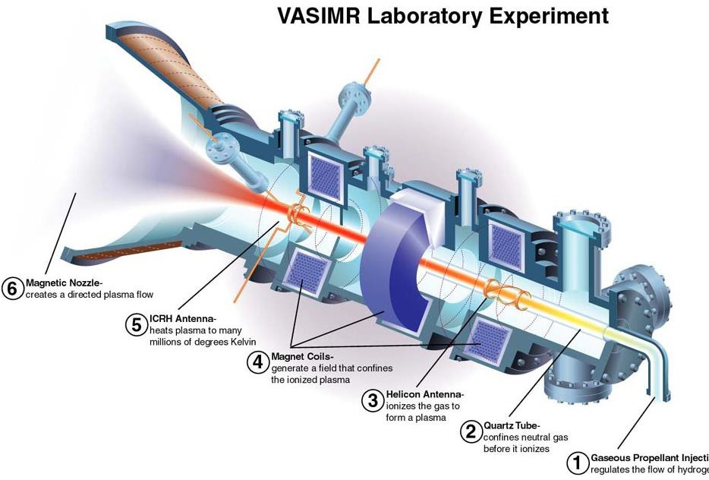
Which Electrical Propulsion Systems exist?
Electromagnetic Propulsion Systems:
Magnetic Nozzle Thruster
L7 – Propulsion Systems
Space Propulsion ENG-510

Slide 26
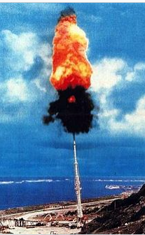
Non-material Ejection Propulsion Systems
Brief overview on non-material ejection space propulsion systems

Slide 27
Which Non-material Ejection Propulsion Systems exist?
Non-material Ejection Propulsion Systems:
Thermal Propulsion Systems
Material Ejection
L7 – Non-material Ejection
Space Propulsion
Space Propulsion ENG-510
Chemical Propulsion Systems
Non-Material Ejection
Electrical Propulsion Systems

Slide 28
Which Non-material Ejection Propulsion Systems exist?
Non-material Ejection Propulsion Systems:
Classical space propulsion systems are today limited as delta v is linked to propellant mass
L7 – Non-material Ejection
Space Propulsion ENG-510

Slide 29
Which Non-material Ejection Propulsion Systems exist?
Non-material Ejection Propulsion Systems:
Material Ejection
L7 – Non-material Ejection
Space Propulsion
Solar Sail
Space Propulsion ENG-510
Catapult launch
Non-Material Ejection
Tether
Beam power

Slide 30
Which Non-material Ejection Propulsion Systems exist?
Non-material Ejection Propulsion Systems:
Rocket advancements
High energy chemical fuels
Nuclear rockets
Propulsion by annihilating antimatter
Magnetic thrust chambers
Air-augmented rockets (e.g. ramjet, scramjet)
L7 – Non-material Ejection
Space Propulsion ENG-510

Slide 31
Which Non-material Ejection Propulsion Systems exist?
Non-material Ejection Propulsion Systems:
Non-rocket advancements
Solar power / solar sail
Catapult launch (e.g. spin launch, canon or slider)
Tether propulsion systems
External beamed power (e.g. Laser)
L7 – Non-material Ejection
Space Propulsion ENG-510

Slide 32
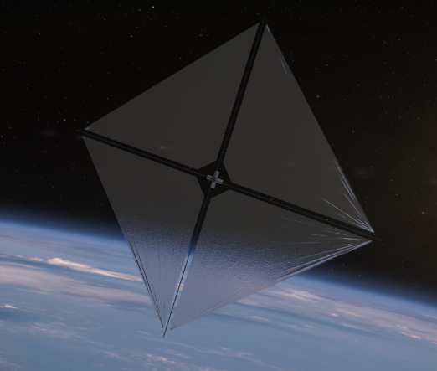
Which Non-material Ejection Propulsion Systems exist?
Non-material Ejection Propulsion Systems:
Solar power / solar sail
L7 – Non-material Ejection
Space Propulsion ENG-510

Slide 33
Which Non-material Ejection Propulsion Systems exist?
Non-material Ejection Propulsion Systems:
Solar power / solar sail
Solar sails use the pressure of sunlight for propulsion, angling toward or away from the Sun so that photons bounce off the reflective sail to push a spacecraft
This eliminates heavy propulsion systems and could enable longer duration and lower-cost missions
Although mass is reduced, solar sails have been limited by the material and structure of the booms, which act much like a sailboat’s mast
But NASA is about to change the sailing game for the future.
A next-generation solar sail technology – known as the Advanced Composite Solar Sail System – was launched aboard Rocket Lab’s Electron rocket
L7 – Non-material Ejection
Space Propulsion ENG-510

Slide 34
Which Non-material Ejection Propulsion Systems exist?
Non-material Ejection Propulsion Systems:
Solar power / solar sail
The technology could advance future space travel and expand our understanding of our Sun and solar system
The Advanced Composite Solar Sail System demonstration uses a twelve-unit (12U) CubeSat built by NanoAvionics to test a new composite boom made from flexible polymer and carbon fiber materials that are stiffer and lighter than previous boom designs
The mission’s primary objective is to successfully demonstrate new boom deployment, but once deployed, the team also hopes to prove the sail’s performance
L7 – Non-material Ejection
Space Propulsion ENG-510

Slide 35
Which Non-material Ejection Propulsion Systems exist?
Non-material Ejection Propulsion Systems:
Solar power / solar sail
Like a sailboat turning to capture the wind, the solar sail can adjust its orbit by angling its sail
After evaluating the boom deployment, the mission will test a series of maneuvers to change the spacecraft’s orbit and gather data for potential future missions with even larger sails
L7 – Non-material Ejection
Space Propulsion ENG-510

Slide 36
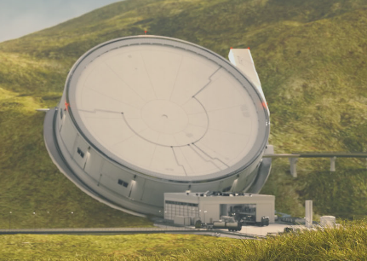
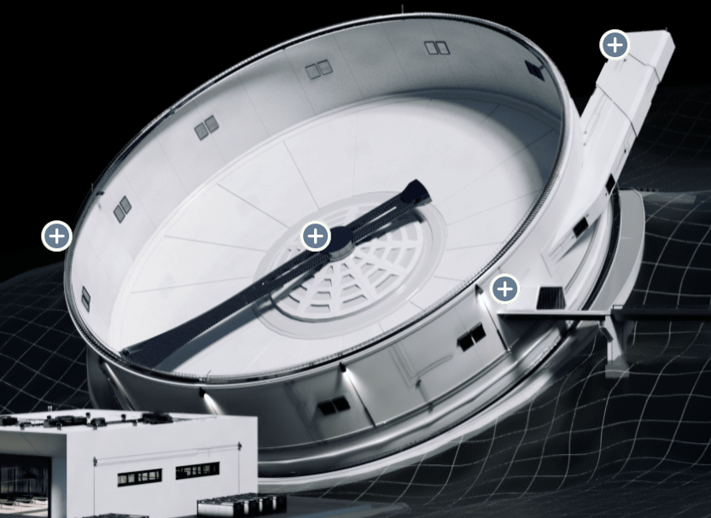
Which Non-material Ejection Propulsion Systems exist?
Non-material Ejection Propulsion Systems:
Catapult launch (e.g. spin launch, canon or slider)
L7 – Non-material Ejection
Space Propulsion ENG-510

Slide 37
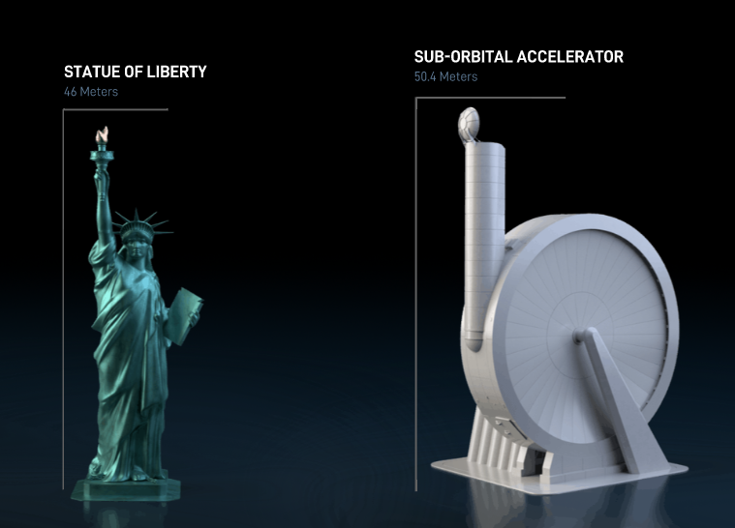
Which Non-material Ejection Propulsion Systems exist?
Non-material Ejection Propulsion Systems:
Catapult launch (e.g. spin launch, canon or slider)
L7 – Non-material Ejection
Space Propulsion ENG-510

Slide 38
Which Non-material Ejection Propulsion Systems exist?
Non-material Ejection Propulsion Systems:
Catapult launch (e.g. spin launch, canon or slider)
Space gun
In Project HARP, a 1960s joint United States and Canada defence project, a 410 mm gun was used to fire a 180 kg projectile at 3,600 m / s (12,960 km / h), reaching an apogee of 180 km, hence performing a suborbital spaceflight
However, a space gun has never been successfully used to launch an object into orbit or out of Earth's gravitational pull
L7 – Non-material Ejection
Space Propulsion ENG-510

Slide 39
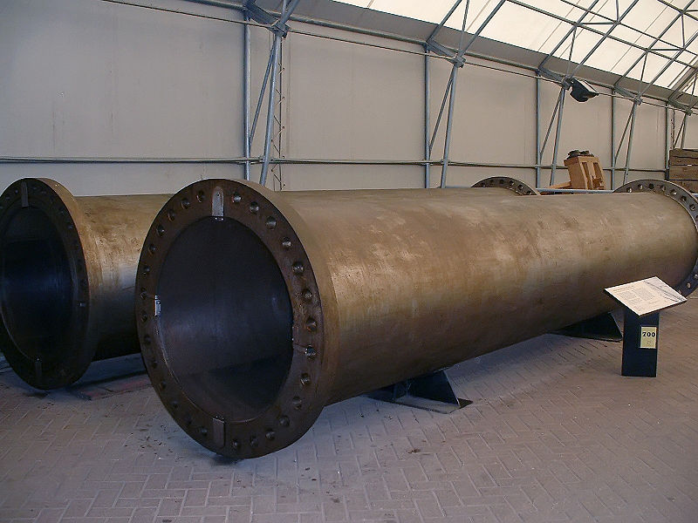
Which Non-material Ejection Propulsion Systems exist?
Non-material Ejection Propulsion Systems:
Catapult launch (e.g. spin launch, canon or slider)
Space gun
In Project HARP, a 1960s joint United States and Canada defence project, a 410 mm gun was used to fire a 180 kg projectile at 3,600 m / s (12,960 km / h), reaching an apogee of 180 km, hence performing a suborbital spaceflight
However, a space gun has never been successfully used to launch an object into orbit or out of Earth's gravitational pull
L7 – Non-material Ejection
Space Propulsion ENG-510

Slide 40
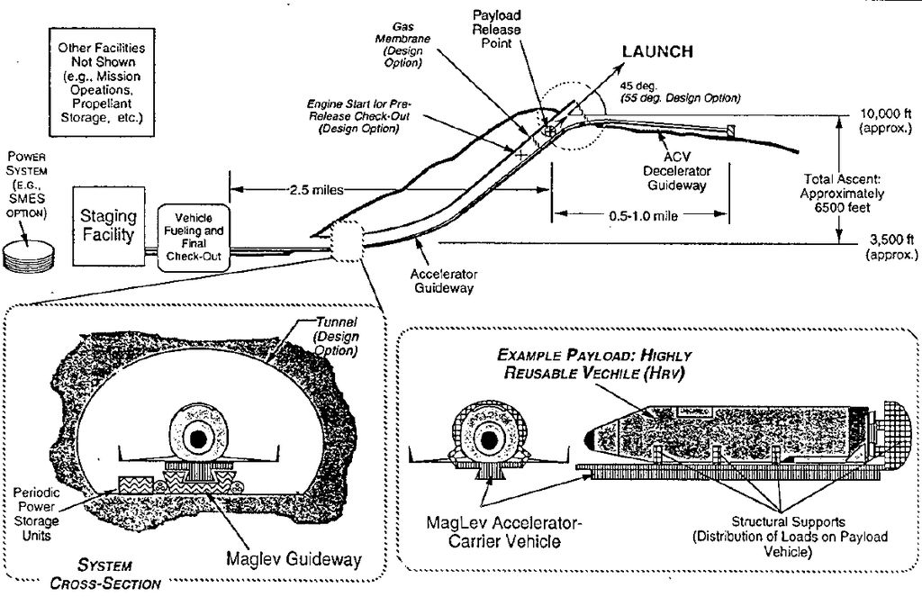
Which Non-material Ejection Propulsion Systems exist?
Non-material Ejection Propulsion Systems:
Catapult launch (e.g. spin launch, canon or slider)
L7 – Non-material Ejection
Space Propulsion ENG-510

Slide 41
Which Non-material Ejection Propulsion Systems exist?
Non-material Ejection Propulsion Systems:
Tether propulsion systems (i.e. plasma brake)
Plasma brake does not use any propellant, instead it utilizes the interaction of ionospheric plasma and a charged micro-tether to generate Coulomb drag
This is similar to atmospheric drag-based devices, but unlike them, micro-tether is safe to other spacecraft and the Coulomb drag is orders of magnitude stronger than atmospheric drag
This difference in deaccelerating forces is even larger as the orbital altitude increases
L7 – Non-material Ejection
Space Propulsion ENG-510

Slide 42
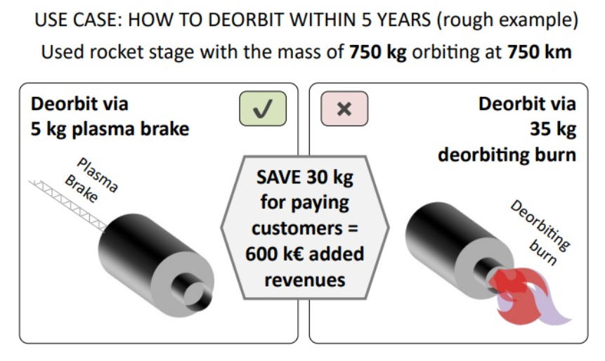
Which Non-material Ejection Propulsion Systems exist?
Non-material Ejection Propulsion Systems:
Tether propulsion systems (i.e. plasma brake)
L7 – Non-material Ejection
Space Propulsion ENG-510

Slide 43
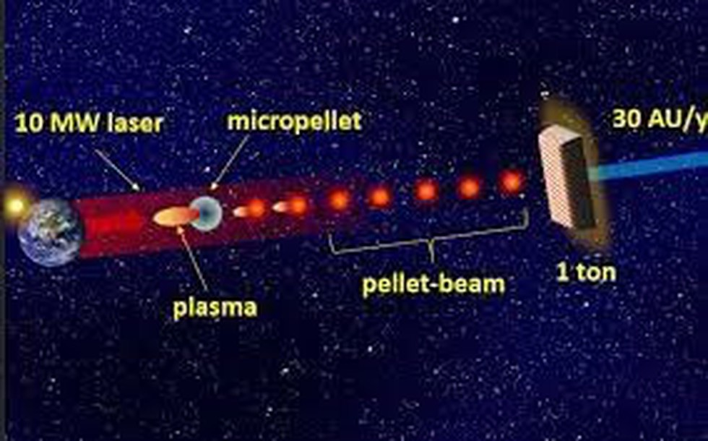
Which Non-material Ejection Propulsion Systems exist?
Non-material Ejection Propulsion Systems:
External beamed power (e.g. Laser)
NASA Innovative Advanced Concepts (NIAC) proposal: Pellet-beam concept
L7 – Non-material Ejection
Space Propulsion ENG-510

Slide 44
Which Non-material Ejection Propulsion Systems exist?
Non-material Ejection Propulsion Systems:
External beamed power (e.g. Laser)
The pellet-beam concept requires two spacecraft – one that sets off for interstellar space, and one that goes into orbit around Earth
The spacecraft orbiting Earth would shoot a beam of tiny microscopic particles at the interstellar spacecraft
Those particles would be heated up by lasers, causing part of them to melt into plasma that accelerates the pellets further, a process known as laser ablation
L7 – Non-material Ejection
Space Propulsion ENG-510

Slide 45
Which Non-material Ejection Propulsion Systems exist?
Non-material Ejection Propulsion Systems:
External beamed power (e.g. Laser)
Those pellets could reach 120 km / s and either hit the sail of the interstellar spacecraft or repel a magnet within it, helping to propel the spacecraft to huge speeds that would let it whizz out of our heliosphere – the bubble of the solar wind around our Solar System
The NIAC proposal examines a new propulsion architecture for fast transit of heavy (1 ton and more) payloads across the Solar System and to the interstellar medium
L7 – Non-material Ejection
Space Propulsion ENG-510

Slide 46
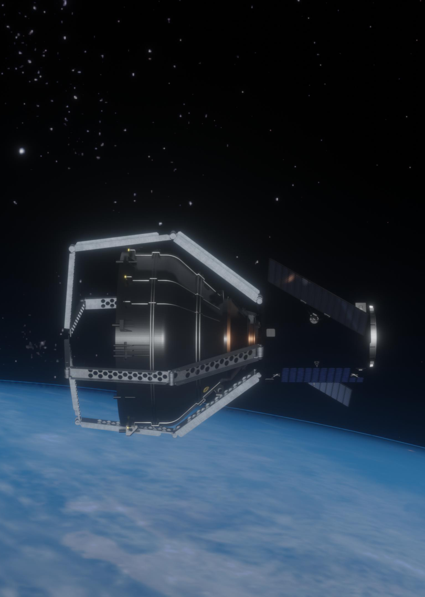
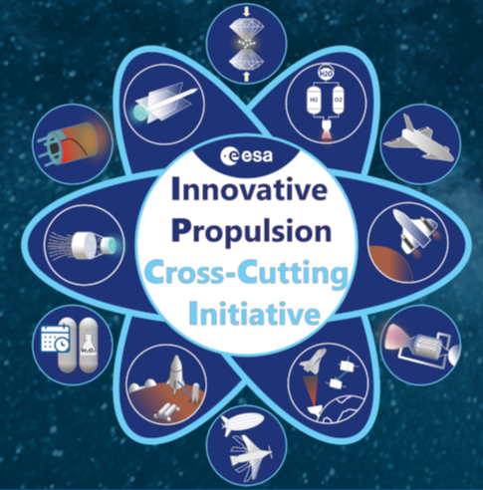
Future Propulsion Systems
Brief overview on future space propulsion systems

Slide 47
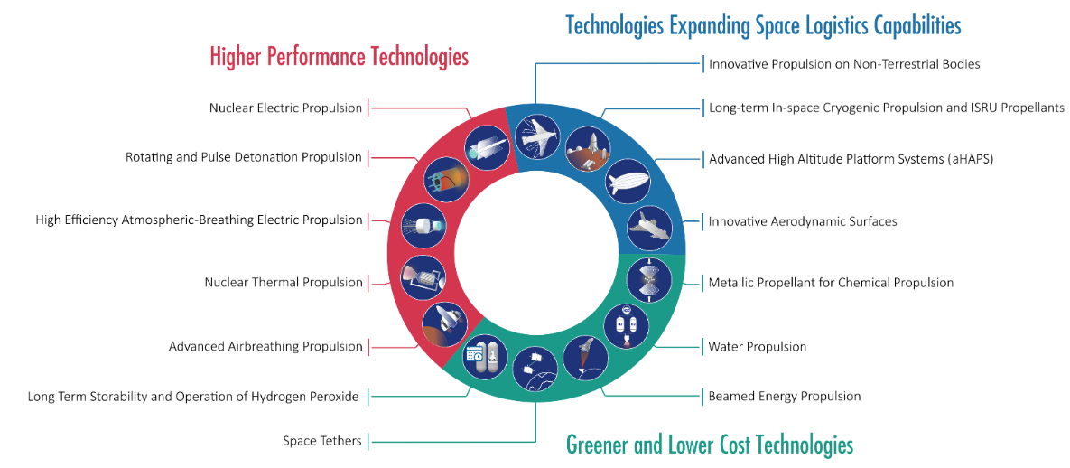
Which Future Propulsion Systems are developed?
ESA Innovative Propulsion – Cross Cutting Initiative:
L7 – Future Propulsion Systems
Space Propulsion ENG-510

Slide 48
Which Future Propulsion Systems are developed?
ESA Innovative Propulsion – Cross Cutting Initiative:
Innovative Propulsion, by definition, shall:
Bring significant positive benefit in terms of mass, performance, cost and flexibility
Be at low TRL yet enough (> TRL 2) to be engineered and demonstrated in a medium term
Enable new missions or applications
Facilitate the creation of new markets
Enhance reliability and competitiveness
L7 – Future Propulsion Systems
Space Propulsion ENG-510

Slide 49
Which Future Propulsion Systems are developed?
ESA Innovative Propulsion – Cross Cutting Initiative:
The objectives of the IP–CCI are:
To identify and support the strategic interest of ESA member states, industry and academia
To stimulate the propulsion ecosystem of the ESA member states
To increase the technology readiness, implement IOV / IOD missions, foster the research, development and testing capabilities and demonstrate the applications and services
To provide an increased visibility of innovative propulsion activities for space
L7 – Future Propulsion Systems
Space Propulsion ENG-510

Slide 50

Which Future Propulsion Systems are developed?
ESA Innovative Propulsion – Cross Cutting Initiative:
Topic # 1 - High Efficiency Atmospheric-Breathing Electric Propulsion
Atmospheric-breathing electric propulsion systems are defined by their capability to generate thrust using as propellant the gases of the atmosphere, which are collected by an intake installed on the same platform
They are capable of operating with variable atmospheric gas mixtures and densities, and resilient to long term operation in a challenging environment
This topic targets innovative electric propulsion systems with high thrust-to-power and high-specific-impulse capability
L7 – Future Propulsion Systems
Space Propulsion ENG-510

Slide 51
Which Future Propulsion Systems are developed?
ESA Innovative Propulsion – Cross Cutting Initiative:
Topic # 2 - Advanced Airbreathing Propulsion
Generating lift by means of atmospheric flight while ingesting the atmospheric oxidizer into the airbreathing engine results into an overall lighter flight vehicle: there is no need to carry the oxidizer and the related storage system on board and the high aerodynamic efficiency L/D > 1 lowers further the required thrust with respect to classical non-lifting vehicles
The main applications are to first stages of launchers, replacing the booster function and potentially performing some of the duty of subsequent stages, or suborbital point-to-point transports
L7 – Future Propulsion Systems
Space Propulsion ENG-510

Slide 52
Which Future Propulsion Systems are developed?
ESA Innovative Propulsion – Cross Cutting Initiative:
Topic # 2 - Advanced Airbreathing Propulsion
Owing to a wide flight regime, potentially from Mach 0 to about 12, the vehicle and its propulsion must perform in an ample operational range
This challenges the design of the propulsion system, which may incorporate variable geometry elements to enlarge the operational regime of the:
Air intake and isolator
Compressor: ram- or turbo based
Combustor and injectors
Nozzle and thrust vectoring
L7 – Future Propulsion Systems
Space Propulsion ENG-510

Slide 53
Which Future Propulsion Systems are developed?
ESA Innovative Propulsion – Cross Cutting Initiative:
Topic # 2 - Advanced Airbreathing Propulsion
As an alternative to the multi-mode variable cycle engine, an engine integrating different propulsion elements can also be considered, e.g. a turbine- or rocket- based combined cycle engine and a (sc)ramjet which provides the required operational range
In either case of a variable cycle engine or a combination of propulsion systems, the following design aspects have a critical impact in the overall performance of the vehicle:
The transition between modes of operation, e.g. turbo to ramjet or ram to scramjet
The overall integration of the propulsion system in the vehicle
The combined aerothermal and aerodynamic loads throughout the mission
L7 – Future Propulsion Systems
Space Propulsion ENG-510

Slide 54
Which Future Propulsion Systems are developed?
ESA Innovative Propulsion – Cross Cutting Initiative:
Topic # 2 - Advanced Airbreathing Propulsion
In either case of a variable cycle engine or a combination of propulsion systems, the following design aspects have a critical impact in the overall performance of the vehicle:
The overall thrust-to-drag (aero-propulsive) balance to assure net thrust and acceleration
The various combustion regimes
The internal flow path design from an aero-thermo-mechanical-structural point of view
The design and integration of the variable geometry components, e.g. intakes, throats and nozzles, by translation, deflection or morphing of the structural elements
L7 – Future Propulsion Systems
Space Propulsion ENG-510

Slide 55
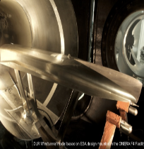
Which Future Propulsion Systems are developed?
ESA Innovative Propulsion – Cross Cutting Initiative:
Topic # 2 - Advanced Airbreathing Propulsion
L7 – Future Propulsion Systems
Space Propulsion ENG-510

Slide 56
Which Future Propulsion Systems are developed?
ESA Innovative Propulsion – Cross Cutting Initiative:
Topic # 3 - Rotating and Pulse Detonation Propulsion
Detonative propulsion engines exhibit superior performance in terms of specific impulse than conventional liquid, hybrid or solid rocket engines
In addition, the pressure gain combustion offers the advantage of lowering the required injection pressure, thus potentially benefiting from an overall reduction in system mass
There are two approaches to realize detonative combustion in a propulsive system: pulse detonation and rotating detonation
Both concepts have the potential of simplifying and reducing the weight of the current propulsion systems
L7 – Future Propulsion Systems
Space Propulsion ENG-510

Slide 57
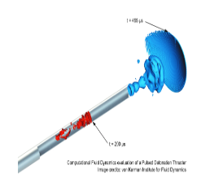
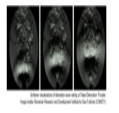
Which Future Propulsion Systems are developed?
ESA Innovative Propulsion – Cross Cutting Initiative:
Topic # 3 - Rotating and Pulse Detonation Propulsion
Although the research on detonative combustion started more than half a century ago, the needs of more affordable and efficient propulsion system justify this breakthrough
L7 – Future Propulsion Systems
Space Propulsion ENG-510

Slide 58
Which Future Propulsion Systems are developed?
ESA Innovative Propulsion – Cross Cutting Initiative:
Topic # 3 - Rotating and Pulse Detonation Propulsion
RTE (Rotating Detonation Engine)
A rotating detonation engine (RDE) uses a form of pressure gain combustion, where one or more detonations continuously travel around an annular channel
Computational simulations and experimental results have shown that the RDE has potential in transport and other applications
In a detonative combustion, the flame front expands at supersonic speed
It is theoretically more efficient than conventional deflagrative combustion by as much as 25% which would provide major fuel savings
Disadvantages include instability and noise
L7 – Future Propulsion Systems
Space Propulsion ENG-510

Slide 59
Which Future Propulsion Systems are developed?
ESA Innovative Propulsion – Cross Cutting Initiative:
Topic # 3 - Rotating and Pulse Detonation Propulsion
RTE (Rotating Detonation Engine)
The basic concept of an RDE is a detonation wave that travels around a circular channel (annulus)
Fuel and oxidizer are injected into the channel, normally through small holes or slits
A detonation is initiated in the fuel / oxidizer mixture by some form of igniter
After the engine is started, the detonations are self-sustaining
One detonation ignites the fuel / oxidizer mixture, which releases the energy necessary to sustain the detonation
The combustion products expand out of the channel and are pushed out of the channel by the incoming fuel and oxidizer
L7 – Future Propulsion Systems
Space Propulsion ENG-510

Slide 60
Which Future Propulsion Systems are developed?
ESA Innovative Propulsion – Cross Cutting Initiative:
Topic # 3 - Rotating and Pulse Detonation Propulsion
RTE (Rotating Detonation Engine)
Although the RDE's design is similar to the pulse detonation engine (PDE), the RDE is superior because the waves cycle around the chamber, while the PDE requires the chambers to be purged after each pulse
L7 – Future Propulsion Systems
Space Propulsion ENG-510

Slide 61
Which Future Propulsion Systems are developed?
ESA Innovative Propulsion – Cross Cutting Initiative:
Topic # 3 - Rotating and Pulse Detonation Propulsion
PTE (Pulse Detonation Engine)
A pulse detonation engine (PDE) is a type of propulsion system that uses detonation waves to combust the fuel and oxidizer mixture
The engine is pulsed because the mixture must be renewed in the combustion chamber between each detonation wave and the next
Theoretically, a PDE can operate from subsonic up to a hypersonic flight speed of roughly Mach 5
Key issues for further development include fast and efficient mixing of the fuel and oxidizer, the prevention of autoignition, and integration with an inlet and nozzle
L7 – Future Propulsion Systems
Space Propulsion ENG-510

Slide 62
Which Future Propulsion Systems are developed?
ESA Innovative Propulsion – Cross Cutting Initiative:
Topic # 4 - Water Propulsion
Water propulsion systems are currently being developed for various applications
In the search for non-toxic, non-carcinogenic and in general non-hazardous replacements of hydrazine, water is the ultimate green propellant
While the specific impulse can be better than that of other monopropellants, the main advantage is the removal of hazards, such as toxicity and adiabatic decomposition of hydrazine
The water is not toxic nor carcinogenic and therefore handling is by definition as safe as, or even safer, than that of any other conceivable green propellant
L7 – Future Propulsion Systems
Space Propulsion ENG-510

Slide 63
Which Future Propulsion Systems are developed?
ESA Innovative Propulsion – Cross Cutting Initiative:
Topic # 4 - Water Propulsion
The main advantages of water propulsion are thus on the one hand the safe storability of the propellant in form of the stable reaction product, water
Water is however also a substance which can be found, in solid state, in various places in the solar system (comets, lunar poles, Martian soil, etc.)
The concept of water propulsion is therefore, beyond the immediate applications as hydrazine replacement in LEO satellites, potentially very useful in future exploration missions, employing a simple form of In-Situ Resource Utilization (ISRU), with only limited propellant processing equipment required
L7 – Future Propulsion Systems
Space Propulsion ENG-510

Slide 64
Which Future Propulsion Systems are developed?
ESA Innovative Propulsion – Cross Cutting Initiative:
Topic # 4 - Water Propulsion
Several different types of water propulsion exist, with possibly the most common current application being Water-Resistojets (WR)
This type of thermo-electric propulsion uses the water itself as propellant
In contrast Water Electrolysis Propulsion (WEP) employs an electrolyser to generate the actual propellants oxygen and hydrogen from the stored water
The two gases are then used to operate conventional chemical propulsion thrusters
Other concepts, like water electrolysis Hall Effect Thrusters (HET) using oxygen and hydrogen for electric propulsion, are also currently under development
L7 – Future Propulsion Systems
Space Propulsion ENG-510

Slide 65
Which Future Propulsion Systems are developed?
ESA Innovative Propulsion – Cross Cutting Initiative:
Topic # 5 - Long Term Storability and Operation of Hydrogen Peroxide
Hydrogen peroxide was developed as a propellant for missiles in the 1940s and 1950s until it was replaced by higher performing combinations of propellants, such as hydrazine in the case of satellites, or cryogenically stored liquid hydrogen / liquid oxygen for launchers
Since the 1990s, hydrogen peroxide development for thrusters (in particular small thrusters in the 5N class) has enjoyed a renaissance of activity, as the desire for non-toxic propellants for spacecraft has increased
Pure hydrogen peroxide will naturally decompose into water (steam) and oxygen given the right catalyst
L7 – Future Propulsion Systems
Space Propulsion ENG-510

Slide 66
Which Future Propulsion Systems are developed?
ESA Innovative Propulsion – Cross Cutting Initiative:
Topic # 5 - Long Term Storability and Operation of Hydrogen Peroxide
Stabilizers are added to the hydrogen peroxide to facilitate the storage and allow the safe use as propellant, thus reducing the purity
These additives have the undesirable effect of reducing the propulsive efficiency, hence their use needs to be minimized wherever possible
In launch vehicle and other short-term applications, a cumulative increase of pressure can be vented overboard to prevent over pressurization of the storage tanks
Nonetheless, this is not desirable, or even nor possible in some cases, for multi-year mission satellites
L7 – Future Propulsion Systems
Space Propulsion ENG-510

Slide 67
Which Future Propulsion Systems are developed?
ESA Innovative Propulsion – Cross Cutting Initiative:
Topic # 5 - Long Term Storability and Operation of Hydrogen Peroxide
on satellites, such as titanium alloys and some stainless steels, facilitate the decomposition of hydrogen peroxide and therefore are not suitable in their current form for the long-term storage of hydrogen peroxide-based propellants
In order to use hydrogen peroxide for long term applications, alternative materials for components and / or alternative stabilizing additives need to be used
L7 – Future Propulsion Systems
Space Propulsion ENG-510

Slide 68




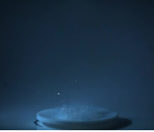

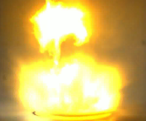
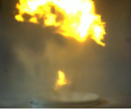
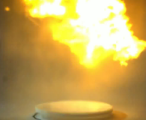
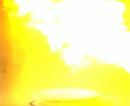
Which Future Propulsion Systems are developed?
ESA Innovative Propulsion – Cross Cutting Initiative:
Topic # 5 - Long Term Storability and Operation of Hydrogen Peroxide
L7 – Future Propulsion Systems
Space Propulsion ENG-510

Slide 69
Which Future Propulsion Systems are developed?
ESA Innovative Propulsion – Cross Cutting Initiative:
Topic # 6 - Innovative Aerodynamic Surfaces
The topic of innovative aerodynamic surfaces comprises ailerons, elevons, flaps, rudders, or panels that modify the aerodynamic characteristics of a vehicle and produce lift and drag forces
Several categories of aerodynamic surfaces are envisaged, subdivided between primary surfaces and complementary surfaces
Primary surfaces are ailerons, elevators, and rudders
Ailerons are mounted on the trailing edge of the flying vehicle and move in opposite directions
L7 – Future Propulsion Systems
Space Propulsion ENG-510

Slide 70
Which Future Propulsion Systems are developed?
ESA Innovative Propulsion – Cross Cutting Initiative:
Topic # 6 - Innovative Aerodynamic Surfaces
Elevators are a moveable part of the horizontal stabilizers, hinged to the back of the tail of the flying vehicle
Rudders are mounted on the trailing edge of the vertical stabilizer, part of the empennage
Complementary surfaces are spoilers, flaps, slats, and airbrakes
Spoilers are used to disrupt the airflow and reduce the lift whereas flaps and slats are used to increase the lift of the flying vehicle. Airbrakes are used to increase drag
L7 – Future Propulsion Systems
Space Propulsion ENG-510

Slide 71
Which Future Propulsion Systems are developed?
ESA Innovative Propulsion – Cross Cutting Initiative:
Topic # 6 - Innovative Aerodynamic Surfaces
This topic focus on the conception, architecture design, technical analysis, development, and operations of Innovative Aerodynamic Surfaces as propulsive mean for a flight vehicle
L7 – Future Propulsion Systems
Space Propulsion ENG-510

Slide 72
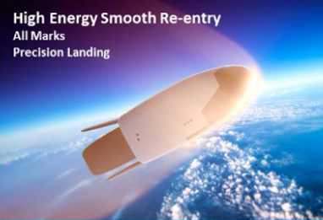
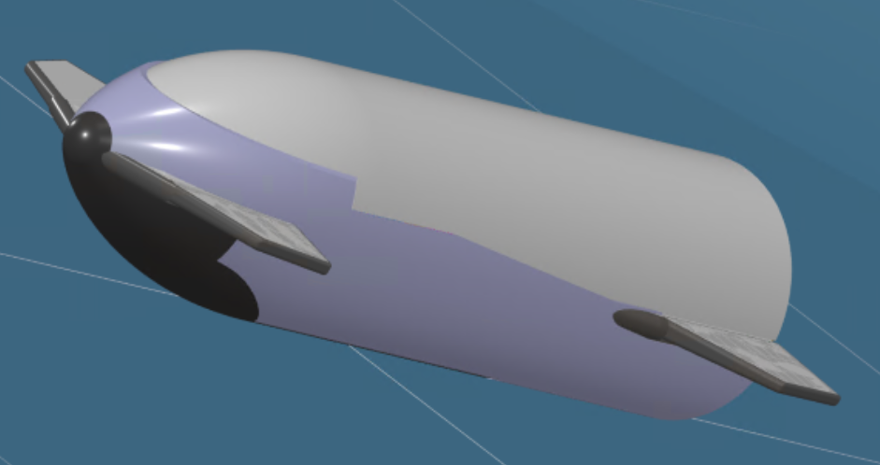
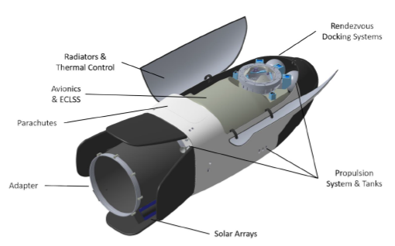
Which Future Propulsion Systems are developed?
ESA Innovative Propulsion – Cross Cutting Initiative:
Topic # 6 - Innovative Aerodynamic Surfaces
L7 – Future Propulsion Systems
Space Propulsion ENG-510

Slide 73
Which Future Propulsion Systems are developed?
ESA Innovative Propulsion – Cross Cutting Initiative:
Topic # 7 - Long-term In-space Cryogenic Propulsion and ISRU Propellants
The higher performance of cryogenic propellants and the ubiquity of their precursor availability in the solar system means that they are perfectly suited for in situ resource utilization (ISRU) and in-orbit re-fueling
Many lunar and Martian missions in particular hope to exploit these propellant options
L7 – Future Propulsion Systems
Space Propulsion ENG-510

Slide 74
Which Future Propulsion Systems are developed?
ESA Innovative Propulsion – Cross Cutting Initiative:
Topic # 7 - Long-term In-space Cryogenic Propulsion and ISRU Propellants
These mission concepts include:
Martian and Lunar transit stages
Propulsive Landers
Space Tugs
Re-fueling stations
Such systems must withstand thermal environments for transfers to Mars / Moon and back, including long duration transfers up to 6 months and dwell time of ~12-24 months
L7 – Future Propulsion Systems
Space Propulsion ENG-510

Slide 75
Which Future Propulsion Systems are developed?
ESA Innovative Propulsion – Cross Cutting Initiative:
Topic # 7 - Long-term In-space Cryogenic Propulsion and ISRU Propellants
Current cryogenic approaches are limited to the much shorter-lived applications for launch vehicles
The requirements for the in-space applications for these propellants will require a significant overhaul of both our understanding of cryogenic propellant management and the product catalogue that has been evolved to exploit them
The scale of these engines will be similar to, or smaller than existing upper stage engines (~ 100 kN)
L7 – Future Propulsion Systems
Space Propulsion ENG-510

Slide 76
Which Future Propulsion Systems are developed?
ESA Innovative Propulsion – Cross Cutting Initiative:
Topic # 7 - Long-term In-space Cryogenic Propulsion and ISRU Propellants
However, they will have additional challenging requirements: large number or restarts/reusability, deep ability to throttle, and clustering of engines for higher thrusts (in applications such as landers and large transfer stages)
To realize a long-term cryogenic propulsion system several key technologies and operational concepts need to be addressed including: low / zero boil off technologies, cryo-fluid handling and management, thermal management of temperature distribution within the tanks and zero / low consumption chill down in preparation for engine operation
L7 – Future Propulsion Systems
Space Propulsion ENG-510

Slide 77

Which Future Propulsion Systems are developed?
ESA Innovative Propulsion – Cross Cutting Initiative:
Topic # 8 - Space Tethers
Space tethers are long, strong, charged cables which can be used for propulsive maneuvers in space thanks to their interaction with charged particles present in the high layers of the atmosphere and in the solar wind
Their working principle allows for propellant-less orbital transfers or de-orbiting satellites at the end of their life
L7 – Future Propulsion Systems
Space Propulsion ENG-510

Slide 78
Which Future Propulsion Systems are developed?
ESA Innovative Propulsion – Cross Cutting Initiative:
Topic # 9 - Beamed Energy Propulsion
A variety of different concepts for space transportation systems with Beamed Energy Propulsion (BEP) engines were proposed in past studies by several different authors
They can be roughly grouped in the following categories:
Plasma: The incoming beamed energy is focused by a mirror system. In the focal point on-board propellant or ambient air is converted into plasma
The ejected plasma propels the vehicle by momentum exchange
Laser ablative propulsion, where the target spacecraft or space debris is ablated to create an impulse, also falls in this category
L7 – Future Propulsion Systems
Space Propulsion ENG-510

Slide 79
Which Future Propulsion Systems are developed?
ESA Innovative Propulsion – Cross Cutting Initiative:
Topic # 9 - Beamed Energy Propulsion
They can be roughly grouped in the following categories:
Thermal: A heat exchanger in the vehicle is heated by beamed energy
The heat is transferred to on-board propellant, which is ejected in a classical convergent-divergent nozzle
A special form of thermal beamed energy propulsion is the solar thermal propulsion stage, where the beam source is the sun
Sail: The beamed energy is reflected by a sail
The resulting radiation pressure exacts a force on the vehicle
The Solar Sail is a specific concept of this category, using the pressure of the solar light for propellant less propulsion
L7 – Future Propulsion Systems
Space Propulsion ENG-510

Slide 80
Which Future Propulsion Systems are developed?
ESA Innovative Propulsion – Cross Cutting Initiative:
Topic # 9 - Beamed Energy Propulsion
They can be roughly grouped in the following categories:
Climber: The climber type is a vehicle for a space elevator type transportation system
The climber will convert beamed energy into mechanical energy used for climbing the tether to the orbital destination station
While the Sail is a feasible approach for in-space applications only, the Climber is a radically different concept and difficult to compare with other propulsion systems
And now the pellet beam…out of NASA Innovative Advanced Concepts (NIAC)
L7 – Future Propulsion Systems
Space Propulsion ENG-510

Slide 81
Which Future Propulsion Systems are developed?
ESA Innovative Propulsion – Cross Cutting Initiative:
Topic # 9 - Beamed Energy Propulsion
They can be roughly grouped in the following categories:
Pellet beam:
L7 – Future Propulsion Systems
Space Propulsion ENG-510

Slide 82
Which Future Propulsion Systems are developed?
ESA Innovative Propulsion – Cross Cutting Initiative:
Topic # 9 - Beamed Energy Propulsion
They can be roughly grouped in the following categories:
Pellet beam: The pellet-beam concept requires two spacecraft – one that sets off for interstellar space, and one that goes into orbit around Earth
The spacecraft orbiting Earth would shoot a beam of tiny microscopic particles at the interstellar spacecraft
Those particles would be heated up by lasers, causing part of them to melt into plasma that accelerates the pellets further, a process known as laser ablation
L7 – Future Propulsion Systems
Space Propulsion ENG-510

Slide 83
Which Future Propulsion Systems are developed?
ESA Innovative Propulsion – Cross Cutting Initiative:
Topic # 9 - Beamed Energy Propulsion
They can be roughly grouped in the following categories:
Those pellets could reach 120 km / s and either hit the sail of the interstellar spacecraft or repel a magnet within it, helping to propel the spacecraft to huge speeds that would let it whizz out of our heliosphere – the bubble of the solar wind around our Solar System
The NIAC proposal examines a new propulsion architecture for fast transit of heavy (1 ton and more) payloads across the Solar System and to the interstellar medium
L7 – Future Propulsion Systems
Space Propulsion ENG-510

Slide 84
Which Future Propulsion Systems are developed?
ESA Innovative Propulsion – Cross Cutting Initiative:
Topic # 10 - Nuclear Electric Propulsion
Space nuclear electric propulsion (NEP) is a technology that utilizes nuclear reactions to generate electricity and propel spacecraft using electric propulsion (EP) thrusters
The idea of using nuclear energy for space propulsion dates back to the 1950s, with the development of nuclear thermal rockets or nuclear power reactors by the US and the Soviet Union
Since then, various countries and organizations have conducted research and development in NEP as it could revolutionize space exploration by enabling faster and more efficient travel through space
L7 – Future Propulsion Systems
Space Propulsion ENG-510

Slide 85
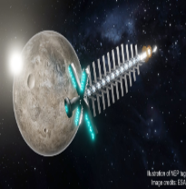
Which Future Propulsion Systems are developed?
ESA Innovative Propulsion – Cross Cutting Initiative:
Topic # 10 - Nuclear Electric Propulsion
Potential applications of NEP include Earth-Moon space tugs, manned missions to Mars, deep space exploration, asteroid mining, or even satellite servicing and maintenance
L7 – Future Propulsion Systems
Space Propulsion ENG-510

Slide 86
Which Future Propulsion Systems are developed?
ESA Innovative Propulsion – Cross Cutting Initiative:
Topic # 11 - Nuclear Thermal Propulsion
In the 1960s and 1970s extensive research on nuclear propulsion was performed by the United States of America and the Soviet Union
Due to financial constraints and a shift in focus, this research did ultimately not lead to operational systems
Meanwhile a lot of progress has been made, not only in reactor technology, but also in material science
Future exploration and science missions with large payload mass and at the same time high delta v demand, can often not be fulfilled by either the available high specific impulse electric propulsion or the available high thrust chemical propulsion
L7 – Future Propulsion Systems
Space Propulsion ENG-510

Slide 87
Which Future Propulsion Systems are developed?
ESA Innovative Propulsion – Cross Cutting Initiative:
Topic # 11 - Nuclear Thermal Propulsion
Already in the early stages of space exploration it became clear that nuclear propulsion and power are key enabling technologies for an extended human presence on moon or Mars
Recently NASA and DARPA announced the plans for a nuclear thermal propulsion demonstrator (DRACO) to be launched within fiscal year 2027
L7 – Future Propulsion Systems
Space Propulsion ENG-510

Slide 88
Which Future Propulsion Systems are developed?
ESA Innovative Propulsion – Cross Cutting Initiative:
Topic # 12 - Metallic Propellant for Chemical Propulsion
The potential use of metals can be exploited not only as a fuel for space vehicles but also as a motivating and promising technology for future “settlement plans” on the Moon and Mars
The prominent features of metal fuel technology are:
It offers a completely CO2-free way to produce heat and/or electrical power and to store energy for deferred uses
It is a safe commodity for trading large energy stocks across the world, thanks to its intrinsically high energy density value
It relies on existing infrastructures, does not require large investments for new power plants, and does limit to the bare minimum its environmental footprint
L7 – Future Propulsion Systems
Space Propulsion ENG-510

Slide 89
Which Future Propulsion Systems are developed?
ESA Innovative Propulsion – Cross Cutting Initiative:
Topic # 12 - Metallic Propellant for Chemical Propulsion
The prominent features of metal fuel technology are:
It is based on a large and practically unlimited resource of fuel food stock and on a fully reversible way to recycle the combustion products in an environmentally friendly manner
The main goal of this technology is to zero the CO2 emissions in the production and recycling processes, as well as in storing and trading energy reserves and assets
L7 – Future Propulsion Systems
Space Propulsion ENG-510

Slide 90
Which Future Propulsion Systems are developed?
ESA Innovative Propulsion – Cross Cutting Initiative:
Topic # 12 - Metallic Propellant for Chemical Propulsion
The prospective propellants are:
Magnesium powder: With the compromise of specific impulse, ignition condition, combustion rate and sufficiency, powdered magnesium is considered as most promising fuel adopted for Mars or Moon Mission based on ISRU
This has huge challenges in terms of feeding powder to a chamber for combustion
Nonetheless, it could be interesting from an in-situ resource utilization perspective in that, if the ISRU processes can convert, for example, lunar regolith metal oxides to metal (e.g. magnesium) and oxygen, these can be used as propellants or an energy source and would be 100% locally sourced
L7 – Future Propulsion Systems
Space Propulsion ENG-510

Slide 91
Which Future Propulsion Systems are developed?
ESA Innovative Propulsion – Cross Cutting Initiative:
Topic # 12 - Metallic Propellant for Chemical Propulsion
The prospective propellants are:
Magnesium powder: Besides, huge abundance of magnesium oxide mineral in Martian regolith has been discovered, which makes the production of magnesium powder on Mars to be possible in the future
Aluminum powder: In energetic applications, such as propellants, pyrotechnics and explosives, aluminum is widely used because of its high combustion enthalpy, easy availability, low toxicity and good stability
Aluminum, whether powders or flakes, is used to increase the energy and raise the flame temperature in rocket propellants
L7 – Future Propulsion Systems
Space Propulsion ENG-510

Slide 92
Which Future Propulsion Systems are developed?
ESA Innovative Propulsion – Cross Cutting Initiative:
Topic # 12 - Metallic Propellant for Chemical Propulsion
The prospective propellants are:
Hydrogen: Physicists Wigner and Hungtinton predicted that hydrogen could turn into an electricity-conducting solid metal at the right temperature and pressure
Metastable metallic hydrogen would be a very light-weight, low volume, powerful rocket propellant
Indeed, for comparison, liquid (molecular) hydrogen-oxygen used in modern rockets performs with an Isp of ~460 s whereas metallic hydrogen has a theoretical Isp of 1700 s
Nonetheless, producing the pressure required to reach that state is extremely complex
L7 – Future Propulsion Systems
Space Propulsion ENG-510

Slide 93
Which Future Propulsion Systems are developed?
ESA Innovative Propulsion – Cross Cutting Initiative:
Topic # 12 - Metallic Propellant for Chemical Propulsion
The prospective propellants are:
Hydrogen: Currently, several laboratories across the world are working with a Diamand Anvil Cell, in which two opposing diamonds with flattened tips squeeze a thin rhenium gasket
Although there are some promising results, this technology is not mature for industrial production of metallic hydrogen
L7 – Future Propulsion Systems
Space Propulsion ENG-510

Slide 94
Which Future Propulsion Systems are developed?
ESA Innovative Propulsion – Cross Cutting Initiative:
Topic # 13 - Advanced High Altitude Platform Systems (aHAPS)
High-Altitude Platform Systems or High-Altitude Pseudo-Satellites are flying vehicles able to fly and/or hover at high altitudes above 20 km in the Earth atmosphere
They can operate as Very Low Earth Observation (VLEO) flight vehicles and are considered as pseudo- or atmospheric-satellites
Their main applications are telecommunications, weather monitoring, and surveillance, similarly to LEO satellites
L7 – Future Propulsion Systems
Space Propulsion ENG-510

Slide 95
Which Future Propulsion Systems are developed?
ESA Innovative Propulsion – Cross Cutting Initiative:
Topic # 13 - Advanced High Altitude Platform Systems (aHAPS)
Another significant application, distinguishing them from conventional LEO satellites, is using them as carrier vehicles for air-launched rockets, making use of the high altitude the flight vehicle can reach
These systems can be in the form of airships, balloons, and airplanes
This topic will evolve around the Flight Vehicle Engineering of such systems, specifically on the advanced propulsion and enhanced aerothermodynamics, making them more efficient while increasing their versatility and performance
L7 – Future Propulsion Systems
Space Propulsion ENG-510

Slide 96
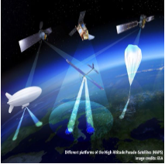
Which Future Propulsion Systems are developed?
ESA Innovative Propulsion – Cross Cutting Initiative:
Topic # 13 - Advanced High Altitude Platform Systems (aHAPS)
L7 – Future Propulsion Systems
Space Propulsion ENG-510

Slide 97
Which Future Propulsion Systems are developed?
ESA Innovative Propulsion – Cross Cutting Initiative:
Topic # 14 - Innovative Propulsion on Non-Terrestrial Bodies
Non-Terrestrial bodies come either with or without an atmosphere where propulsive systems and units would relate to landers or observation vehicles (e.g. drones…)
In absence of an atmosphere, one would rather need rocket engines to translate a craft both horizontally and vertically
In the presence of an atmosphere, one can exploit it to generate lift or to hover by means of aerodynes and aerostats
Within the class of aerodynes, one can distinguish between rotorcraft or fixed-wing planes
L7 – Future Propulsion Systems
Space Propulsion ENG-510

Slide 98
Which Future Propulsion Systems are developed?
ESA Innovative Propulsion – Cross Cutting Initiative:
Topic # 14 - Innovative Propulsion on Non-Terrestrial Bodies
In both cases, lift is generated by fluid-dynamic forces which carry the weight whereas the propulsion system generates the thrust to compensate for the drag and provide the acceleration
For aerostats, e.g. balloons, dirigibles…, lift is generated by buoyancy, while lateral translation is generated by wind (drag) or a propulsion unit
This propulsive unit can either make use of the atmosphere by means of e.g. an electrical driven fan, an oxidizer breathing engine, a fuel breathing engine... or fall back to a rocket engine not relying on the atmosphere
L7 – Future Propulsion Systems
Space Propulsion ENG-510

Slide 99
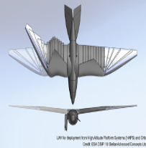
Which Future Propulsion Systems are developed?
ESA Innovative Propulsion – Cross Cutting Initiative:
Topic # 14 - Innovative Propulsion on Non-Terrestrial Bodies
Finally, among these different propulsion innovations, one should assess what power sources feed the engine, namely electrical (photovoltaic or nuclear), chemical (mono- or bi-propellant), ‘fluid’-breathing (using the species in the atmosphere), where the chemical propellant might be coming from an ISRU plant
L7 – Future Propulsion Systems
Space Propulsion ENG-510

Slide 100
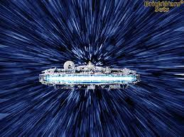
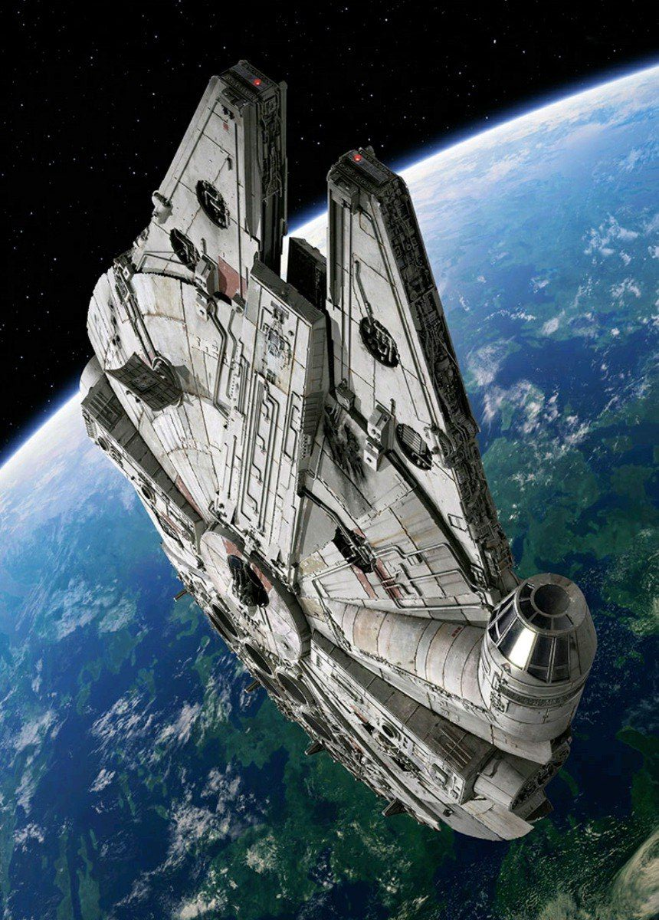
Lecture # 7 Summary
Brief synthesis on space propulsion course

Slide 101
Which Summary of Lecture is given?
Summary:
Basic idea of space propulsion course is to give (nearly) complete overview on all propulsion systems related to space (from lift-off on ground to deep-space exploration)
This idea is in principle achieved by intense discussion on thermal, chemical and electrical propulsion systems as well as non-material ejection propulsion systems and future propulsion systems
More detailed information needs to be collected by yourself!
L7 – Summary
Space Propulsion ENG-510

Slide 102
EPFL Space Center eSpace
The End
Space Propulsion ENG-510

Slide 103
Lecture # 7 Introduction & General Course Information
Brief update on space propulsion course

Slide 104
Launch Event
Launch Schedule:
Tuesday, May 27
Between 9 am and noon
All groups shall be present during the complete event (constraints w.r.t. exams will be for sure considered)
Weather is out of control
It is highlighted that booster / core stage fixation shall be strengthened
L7 - Introduction
Space Propulsion ENG-510

Slide 105
Oral Exam
Schedule:
Wednesday, July 2 and Thursday, July 3
Excel table is uploaded on Moodle
Please fill out table
L7 - Introduction
Space Propulsion ENG-510

Slide 106
Oral Exam
Use Case Example:
A propulsion system shall be designed for a GEO (Geostationary Earth Orbit) satellite
Spacecraft mass is 6 tons
Spacecraft lifetime is 10 years
Propulsion system shall ensure attitude control of the spacecraft over the complete lifetime
Main trade-off criterions for the propulsion system are simplicity (simple architecture), robustness (mature technology) and price (small number of components)
Main performance requirements are thrust [1 N], thrust duration [10.000 s], total impulse [10.000 Ns] and MIB (Minimum Impulse Bit) [0.1 Ns]
L7 - Introduction
Space Propulsion ENG-510

Slide 107
Oral Exam
Use Case Example:
Which propulsion systems could be considered?
Which propulsion system do you propose?
How do you justify your selection (advantages, disadvantages of the different propulsion systems)?
Can you explain different methods to ignite an engine?
L7 - Introduction
Space Propulsion ENG-510

Slide 108
Oral Exam
Use Case Example:
Can you explain following graph …?
100
v_{e} = 2 km / s
v_{e} = 4 km / s
L7 - Introduction
MR [-]
10
Space Propulsion ENG-510
v_{e} = 10 km / s
v_{e} = 30 km / s
1
0
20
0
5
10
15
Delta v [km / s]

Slide 109
Oral Exam
Use Case Example:
You have 5 minutes for preparation of your answers
Afterwards Q & A will be performed
L7 - Introduction
Space Propulsion ENG-510

Slide 110
Oral Exam
02.07.2025
8:00 - 8:30 | Tania Rosset
8:30 - 9:00 | Antoine Marchand
9:00 - 9:30 | Michaël Fuser
9:30 - 10:00 | Sven Profichet
10:00 - 10:30 | Mike Michel Bauer
10:30 - 11:00 | João von Haehling
11:00 - 11:30 | William Martin
11:30 - 12:00 | Alexis RUPRECHT
Break
13:00 - 13:30 | Thibault Bardet
13:30 - 14:00 | Guillaume Keusch
14:00 - 14:30 | Patrick Alexis Zvezdin
14:30 - 15:00 | Alexandre Aires Viegas
15:00 - 15:30 | Florian Kurz
15:30 - 16:00 | maximilien Rochat
16:00 - 16:30 | Pierre-Sylvain Rosset
16:30 - 17:00 | Ramon Heeb
17:00 - 17:30 | Alfonso Monna
17:30 - 18:00
Use Case Example:
Wednesday, July 2
L7 - Introduction
Space Propulsion ENG-510

Slide 111
Oral Exam
03.07.2025
8:00 - 8:30
8:30 - 9:00
9:00 - 9:30
9:30 - 10:00 | Maxime Bugnion
10:00 - 10:30 | Melani Cvetkovska
10:30 - 11:00 | Loris Hegg
11:00 - 11:30 | Tom Rathjens
11:30 - 12:00 | Bron Ward
Break
13:00 - 13:30 | Jehan Corcelle
13:30 - 14:00 | Oscar Foubert
14:00 - 14:30 | Sameh Lahouar
14:30 - 15:00 | Marcel Zelent
15:00 - 15:30 | Maximilian Bonvin
15:30 - 16:00 | Ryan Svoboda
16:00 - 16:30 | Aliénor Perruchio
16:30 - 17:00
17:00 - 17:30
Use Case Example:
Thursday, July 3
L7 - Introduction
Space Propulsion ENG-510

Slide 112
Feedback
Feedback:
Tool is running
Please provide feedback
Number of ECTS points was checked and is considered as fair following EPFL regulations
New lecture going more in propulsion details is in preparation
L6 - Introduction
Space Propulsion ENG-510

Slide 113
Future Evolution
Potential additional lecture (first ideas):
Detailed equipment design
3d printing of parts
Testing
Final verification together with New Space Company
L6 - Introduction
Space Propulsion ENG-510

Slide 114
Test Facility Visit
ERT Test Facility Visit (including firing demonstration):
Test facility visit is proposed for Wednesday, May 28 with departure at 9 am
No interest?
L6 - Introduction
Space Propulsion ENG-510

Slide 115
The End
Thank you!
All the best!
Do not hesitate to reach out to me!
L6 - Introduction
Space Propulsion ENG-510

Slide 116
EPFL Space Center eSpace
The Real End
Space Propulsion ENG-510

